Slide 1

Barber shop project
Priority scheduling

Slide 2
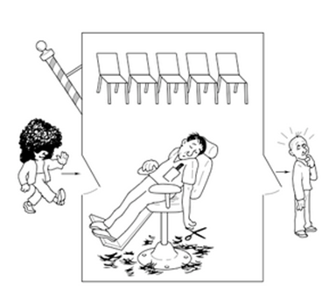
We have one barber chair and 5 customer waiting chairs ,
When there is no customer the barber sleeps on the barber chair, when the customer arrives he will wake the barber up or wait at the customer chair when the barber cutting some one else hair, when the chairs are full the new customer will leave

Slide 3
In our project we will assume that all the customers will arrive at the same time and the barber will take them by their priority.
Priority scheduling: a priority number (integer) is associated with each process.
The CPU is allocated to the process with the highest priority (smallest integer = highest priority).
Assume number of customers is 10 and simulation time will be 25

Slide 4
Barbershop.h:
/* * BarberShop.h -- Barber shop for sleeping barber * problem */
#ifndef _BARBERSHOP_H_
#define _BARBERSHOP_H_
#include "Lock.h“
#include "CV.h“
const int NCHAIRS = 5;
const int NO_CUST_CLOSING_TIME = -1;
class BarberShop{
private:
Lock lock;
CV wakeBarber;
CV nextCustomer;
bool timeToClose;
bool open;
int arrivalCount;
int cutCount;
//int fullCount;
public:
BarberShop();
~BarberShop() {};
void barberDay();
// Main loop for barber thread
bool getHairCut(); // Called by customer thread void ClosingTime(); // Called by clock thread private:
void openStore();
int waitForCustomer();
void doneCutting();
void printFinalStats();
void swap(int *xp, int *yp);
void selectionSort(int arr[],int arr2[] ,int n); bool stillNeedHaircut(int custId);
bool waitingRoomFull();};
#endif

Slide 5
Barbershop.cc:
/*
* BarberShop.cc -- Barber shop for sleeping barber
* problem
*/
#include <assert.h>
#include <errno.h>
#include <pthread.h>
#include <stdio.h>
#include <sys/time.h>
#include "BarberShop.h"
#include "Lock.h"
#include "CV.h"
#include "thread.h"
// Routine constructor
// conditional variables to be changed later in the code
BarberShop::BarberShop()
{
open = false;
timeToClose = false;
arrivalCount = 0;
cutCount = 0; }
void BarberShop::barberDay()
{
// BarberDay is not an atomic action.
// No lock. Only touch object's state
// by calling methods that lock.
int cust;
printf("Opening for the day\n");
openStore();
while(1){
cust = waitForCustomer();
if(cust == NO_CUST_CLOSING_TIME){
printf("Closing for the day No customer\n");
ClosingTime();
printFinalStats();
return;
}
}
else if ( cust == -2) {
printf("Closing for the day the time is over\n");
printFinalStats();
return; }

Slide 6
printf("Cut hair %d\n", cust);
thread_sleep(1, 0); // Time to cut
doneCutting();
}
}
void BarberShop::openStore()
{
lock.acquire();
open = true;
lock.release();
return;
}
int BarberShop::waitForCustomer()
{
int custId;
int arr[] = {3,5,7,1,9,2,8,6,4,10}; // priority
int arr2[] ={0,1,2,3,4,5,6,7,8,9}; // customer number
int n = sizeof(arr)/sizeof(arr[0]); // number of customers
selectionSort(arr,arr2 ,n);
lock.acquire();
while(!(timeToClose || arrivalCount > cutCount )){ //emptyAndOpen
wakeBarber.wait(&lock);
}
if(timeToClose){
open = false; custId=-2;// Stop new arrivals closing time terminates the program
}
else if(arrivalCount > cutCount){ // Serving customers still in the while loop. number of customers < number of required customers of the day
custId = arr2[cutCount];
}
else{
custId = NO_CUST_CLOSING_TIME; //-1 customers reached the maximum number. No customers allowed.
}
lock.release();
return custId;
}

Slide 7
void BarberShop::doneCutting()
// Inceasing cut count. Look up if there are any waiting customers.
{
lock.acquire();
cutCount++;
nextCustomer.broadcast();
lock.release();
return;
}
void BarberShop::printFinalStats() // Prints the number of the customers served and the customers who came to the salon.
{
lock.acquire();
printf("Stats: arr=%d cut=%d \n",
arrivalCount,cutCount);
assert(arrivalCount == cutCount);
lock.release();
}
bool BarberShop::getHairCut()
{
int myNumber;
bool ret;
lock.acquire();
if(!open || waitingRoomFull()){ // Customer coming will be in the waiting list.
ret = false;
}
else{ // Salon is open and customer will be served
myNumber = ++arrivalCount;
wakeBarber.signal(); // Turning the state of barber from idle to working.
while(stillNeedHaircut(myNumber)){ nextCustomer.wait(&lock); }

Slide 8
ret = true;
}
lock.release();
return ret;
}
void BarberShop::ClosingTime()
{
lock.acquire();
timeToClose = true;
wakeBarber.signal();
lock.release();
}
// swapping the two values by reference
void BarberShop::swap(int *xp, int *yp)
{
int temp = *xp;
*xp = *yp;
*yp = temp;
}
void BarberShop::selectionSort(int arr[],int arr2[] ,int n)
{
int i, j, min_idx;
// One by one move boundary of unsorted subarray
for (i = 0; i < n-1; i++)
{
// Find the minimum element in unsorted array
min_idx = i;
for (j = i+1; j < n; j++)
if (arr[j] < arr[min_idx])
min_idx = j;
// Swap the found minimum element with the first element
swap(&arr[min_idx], &arr[i]);
swap(&arr2[min_idx], &arr2[i]);
}
}

Slide 9
bool BarberShop::stillNeedHaircut(int custId) // Customers won't be served immediately but their number is less than the maximum served number.
{
if(custId > cutCount){
return true;
}
else{
return false;
}
}
bool BarberShop::waitingRoomFull()
{
// +1 b/c barber chair
if(arrivalCount-cutCount == NCHAIRS+1){ // CHecks if the room is full
return true;
}
else{ // Room is not full yet.
return false;
} }

Slide 10
Barbershop main:
#include <stdio.h>
#include "BarberShop.h"
#include "thread.h"
#include <vector>
#define NCUST 10
#define SIMTIME 25
void *barberMain(void *bsPtr)
{
BarberShop *bs = (BarberShop *)bsPtr;
bs->barberDay();
return NULL;
}
void *custMain(void *bsPtr)
{
bool ret;
BarberShop *bs = (BarberShop *)bsPtr;
while(1){
ret= bs->getHairCut();
thread_sleep(1, 0); // Barber takes one moment to rest
if(ret == true) return NULL;
}
//return NULL;
}
void *clockMain(void *bsPtr)
{
BarberShop *bs = (BarberShop *)bsPtr;
thread_sleep(SIMTIME, 0);
printf("CLOCK: Closing time\n");
bs->ClosingTime();
return NULL;
}
int main(int argc, char **argv)
{
int ii;
BarberShop *bs = new BarberShop();
pthread_t barber;
pthread_t customers[NCUST];
pthread_t clock;

Slide 11
pthread_create(&barber, NULL, barberMain, bs);
for(ii = 0; ii < NCUST; ii++){
pthread_create(&customers[ii], NULL, custMain, bs);
}
pthread_create(&clock,NULL, clockMain, bs);
thread_join(barber);
}

Slide 12
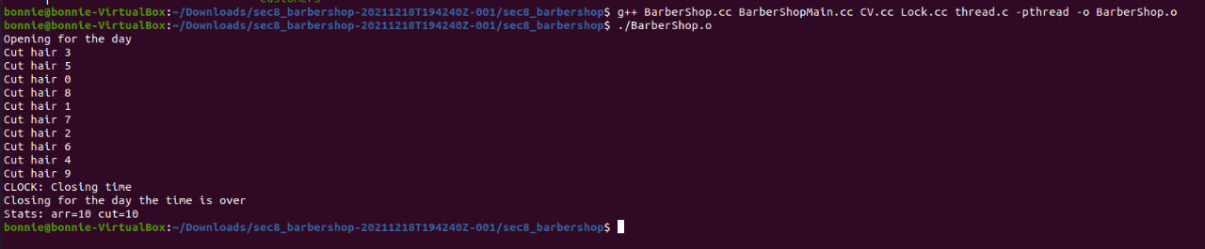
Output:

Slide 13
Team names:
ساره جلال عبد الخالق الخولي
زينب صبري أبوالمكارم علي ابوالعلا
غدير احمد عبدالفتاح الصلحاوي
حبيبة محمد يوسف عبدالمقصود هجرس
ياسمينا عبد الرءوف عبدالحكيم نصير
روفيده محمد إبراهيم قطب
ندا ياسر محمود محمد علي

